Slide 1
CAKE DELIGHTS
PREPARED BY:R.dileep

Slide 2
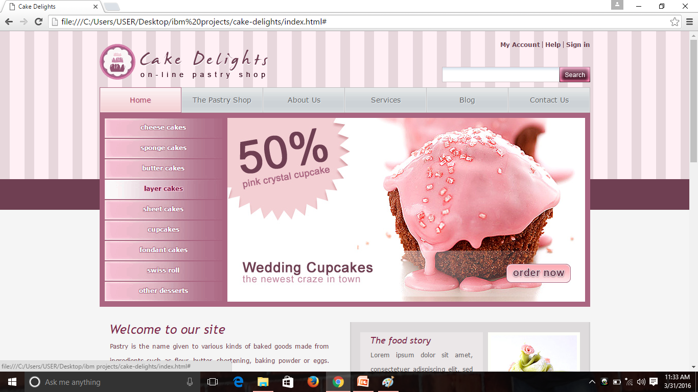
Open delicious cakes click read more and buy it

Slide 3
ORDER IT.

